Slide 1
SGGSJ GOVT.COLLEGE
TYPES OF NETWORK
(BCA / PGDCA)

Slide 2
What is Network?
A network consists of two or more computers that are linked in order to share resources (such as printers and CDs), exchange files, or allow electronic communications.
The computers on a network may be linked through cables, telephone lines, radio waves, satellites, or infrared light beams.

Slide 3
Different Types of Networks
Depending upon the geographical area covered by a network, it is classified as:
  Local Area Network (LAN)
  Metropolitan Area Network (MAN)
  Wide Area Network (WAN)
  Personal Area Network (PAN)

Slide 4
Local Area Network (LAN)
A LAN is a network that is used for communicating among computer devices, usually within an office building or home.
LAN’s enable the sharing of resources such as files or hardware devices that may be needed by multiple users
•
Is limited in size, typically spanning a few hundred meters, and no more than a mile
Is fast, with speeds from 10 Mbps to 10 Gbps
Requires little wiring, typically a single cable connecting to
each device
Has lower cost compared to MAN’s or WAN’s

Slide 5
Local Area Network (LAN)
LAN’s can be either wired or wireless. Twisted pair, coax or fibre optic cable can be used in wired LAN’s.
Every LAN uses a protocol – a set of rules that governs how packets are configured and transmitted.
Nodes in a LAN are linked together with a certain
topology. These topologies include:
  Bus
  Ring
  Star
LANs are capable of very high transmission rates (100s Mb/s to G b/s).

Slide 6
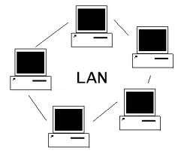
Local Area Network (LAN)

Slide 7
Advantages of LAN
Speed
Cost
Security
E-mail
Resource Sharing

Slide 8
Disadvantages of LAN
Expensive To Install
Requires Administrative Time
File Server May Fail
Cables May Break

Slide 9
Metropolitan Area Network (MAN)
A metropolitan area network (MAN) is a large computer network that usually spans a city or a large campus.
A MAN is optimized for a larger geographical area than a LAN, ranging from several blocks of buildings to entire cities.
A MAN might be owned and operated by a single organization, but it usually will be used by many individuals and organizations.

Slide 10
Metropolitan Area Network (MAN)
A MAN often acts as a high speed network to allow sharing of regional resources.
A MAN typically covers an area of between 5 and 50 km diameter.
Examples of MAN: Telephone company network that provides a high speed DSL to customers and cable TV network.

Slide 11
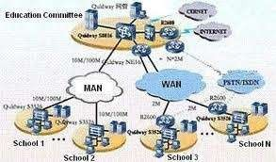
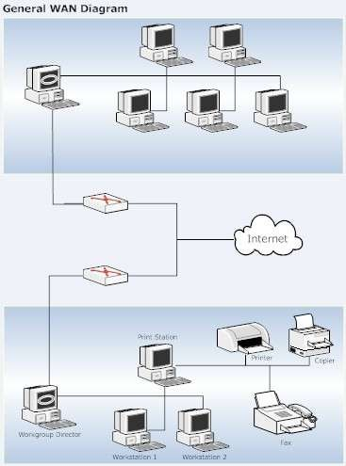
Metropolitan Area Network (MAN)

Slide 12
Wide Area Network (WAN)
WAN covers a large geographic area such as country, continent or even whole of the world.
A WAN is two or more LANs connected together. The LANs can be many miles apart.
To cover great distances, WANs may transmit data over leased high-speed phone lines or wireless links such as satellites.

Slide 13
Wide Area Network (WAN)
Multiple LANs can be connected together using devices such as bridges, routers, or gateways, which enable them to share data.
The world's most popular WAN is the Internet.

Slide 14
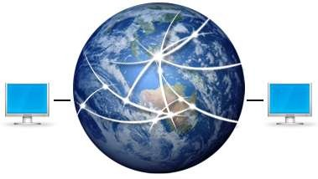
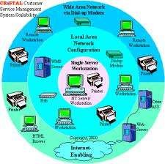
Wide Area Network (WAN)

Slide 15


